Slide 1

Analysis of Default
April 2024

Slide 2
Main objectives
Explore dataset trends related to loan defaults.
Investigate factors contributing to the risk of loan defaulting.
Identify customer groups with the highest risk of default.
Build a machine learning model to predict default probabilities.
Recommend effective strategies to reduce loan defaults.

Slide 3
Data Overview
10970 Samples from 9 regions and 7 branches
Data is imbalanced: 1307 default and 9663 not default clients
Moth male and female clients aged between 18 and 78 years old
2 types of loans: leaseback and leasing
3 main interest rates: 3.374%, 2.671% and 2.53%

Slide 4
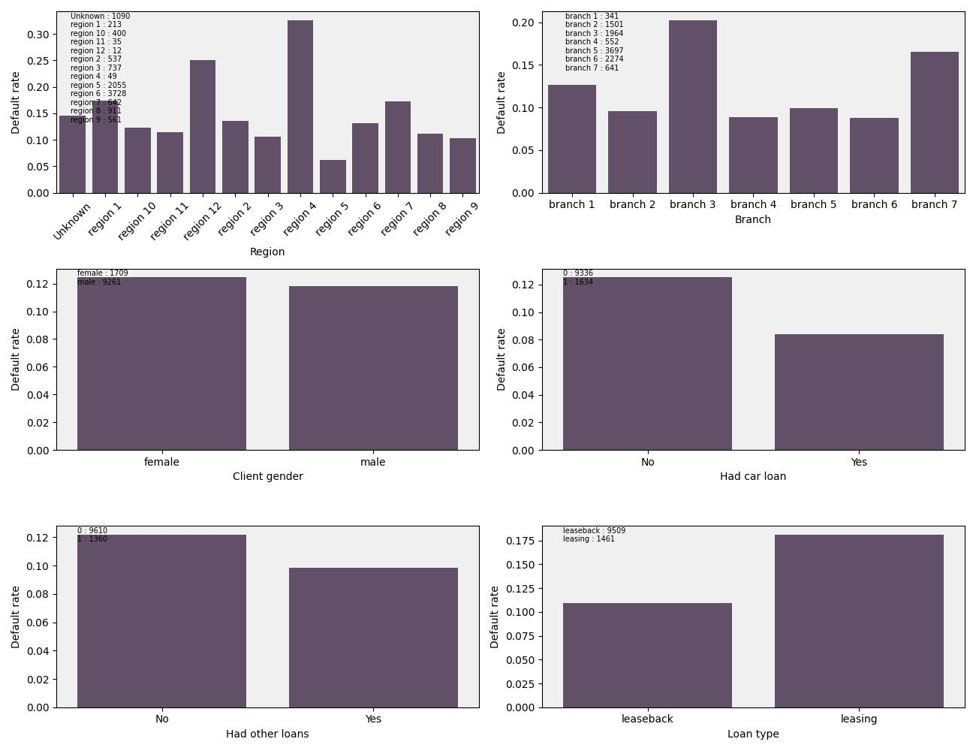
Default rate in different subgroups

Slide 5
Default rate in regions and branches
Regions
There are two regions with relatively high default rates: region 4, which has the highest rate at 33%, and region 12 with a default rate of 25%.
In contrast, region 5 has the lowest default rate at 6%. Notably, unlike regions 2 and 4 where high rates may be attributed to insufficient data, region 5 also has a sufficient number of clients.
Branches
2 branches, 3 and 7, have relatively high default rates, 20% and 16% respectively.
Default rates in other branches is approximately same, 8-12 %

Slide 6
Default rate by gender, loan availability and type
Gender
Default rates in both gender groups are the same, apx. 12%
Have loans
Clients with other loans, regardless of having a car loan or not, exhibit lower default rates than clients without any loans.
Specifically, clients with a car loan have a default rate of 8%, whereas clients with other types of loans have a default rate of 10%
Loan type
Clients with leasing agreements have as twice higher default rate as clients with leaseback agreements, 18% compared to 11%.
It's worth mentioning that the number of leasing clients is six times less than the number of leaseback clients

Slide 7
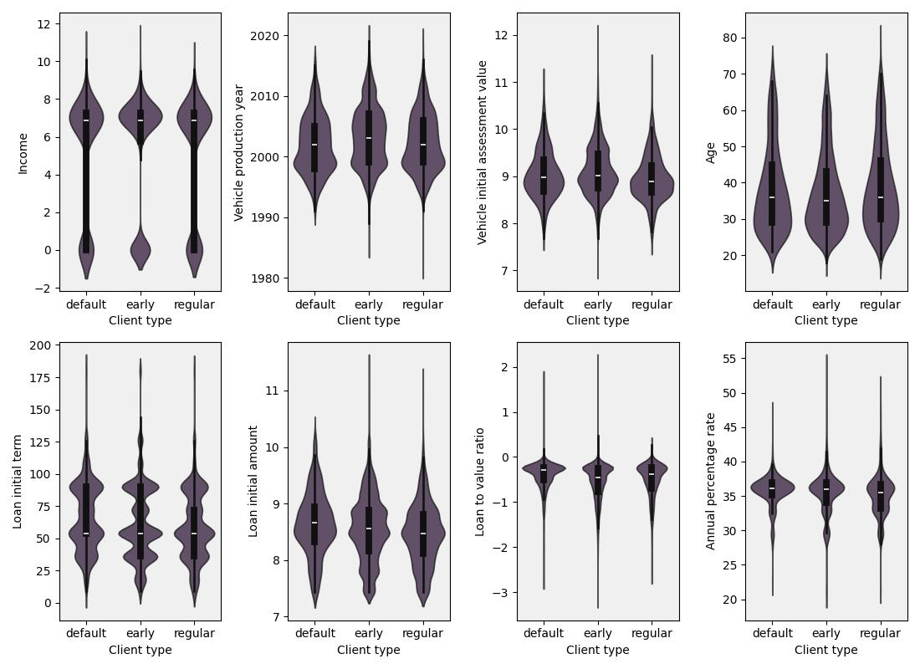
Distribution of factors in client subgroups*
* Income, loan amounts, and asset values are logged for visualization and normalization purposes

Slide 8
Default rate in regions and branches
All 3 types of clients, in average, have the same level of income. The highest level of income have clients who returned loan earlier.
In average, default clients are buying older vehicles, although the mean value of vehicles are the same with regular clients.
The age groups across the three client segments are relatively similar, ranging from 28 to 4 5 years old on average
Both loan term and loan amount, in average, are higher in default client group. Interestingly, the highest loan amounts are in regular and early client groups
Finally, as expected, in default group loan to value ration is, in general, higher.

Slide 9
Models to predict default probabilities
Model Score | Logistic regression | Support Vector Classifier | Random Forest Classifier
F-beta (beta = 2) | 0.433 | 0.45 | 0.46
Precision | 0.14 | 0.17 | 0.15
Recall | 0.915 | 0.75 | 0.91
During the analysis, three models were trained: Logistic Regression, Support Vector Machine, and Random Forest. The F-beta score was chosen as the selection criterion, as it not only represents the combination of Precision and Recall but also provides the option to control the importance of recall. In our case, a beta value of 2 was chosen, as recall is more important than precision for default prediction. Based on this, the best model was found to be the Random Forest. However, while the model correctly predicts 91% of true default cases, it struggles with correctly predicting non-default cases, indicating a need for further improvement

Slide 10
Recomendations
Collect more data, especially default cases.
Review loan provision policies in regions 12 and 4. Also, consider adopting the procedures used in region 5, which appear to be the most efficient at present.
Investigate the reasons behind the high default rates in branches 3 and 7, and update the scoring model and staff training as needed.
Update the terms of leasing loans to make them more stringent and improve risk management.
If the income variable has an excessively high weight in the scoring model, consider reducing its impact. Instead, allocate more weight to variables such as vehicle value and loan amount to achieve a more balanced and accurate risk assessment.

